Slide 1
Global Marketing
Management
A European Perspective
Global Segmentation,
Targeting and Positioning

Slide 2
Global Market Segmentation
... is the process of dividing the world market
into distinct subsets of customers
that have similar needs
(eg country groups or individual interest groups).

Slide 3
Criteria for
Global Market Segmentation
Geographic segmentation
  geographic subsets
Demographic segmentation
  eg age, gender, income, occupation
Psychographic segmentation
Behaviour segmentation
Benefit segmentation

Slide 4
Psychographic Segmentation
... is based on attitudes, values and lifestyle
... is measured through extensive item batteries which cover activities, interests and opinions (AIO-studies)
lifestyle surveys, eg by

Slide 5
Behaviour and Benefit Segmentation
Behaviour segmentation
  Focus on whether and how much people buy or use a product;
  eg usage rates: heavy , medium, and light users, and nonusers
  eg user status: potential users, nonusers, ex-users, regulars, first timers, and users of competitors’ products
Benefit segmentation
  Today, consumers basic needs are fulfilled. Therefore, consumers seek additional value from purchase decisions;
  eg cars: in addition to movement buyers seek personal safety, image, superior engine power (speed) etc.

Slide 6
Global Targeting
After markets have been segmented, targeting
aims at evaluating and comparing the indentified
segments in order to select one or more as
prospect(s) with the highest potential.

Slide 7
Criteria for Targeting
As in single-country targeting, the most important criteria are:
Current size of the segment and anticipated growth potential
Competitive intensity and potential competition
Compatibility with the company’s overall objectives and the feasibility of successfully reaching a designated target

Slide 8
Selecting a
Global Target Market Strategy
standardised global marketing
  i.e. mass marketing, the same marketing mix for a broad market of potential buyers; e.g. Revlon
concentrated global marketing
  targeted at a single segment of the global market, e.g. Winterhalter (German dishwashers for hotels)
differentiated global marketing
  2 or more different segments; e.g. VW (cars for various target groups: Porsche, Skoda, VW Golf etc.)

Slide 9
Global Product Positioning
is the location of a product in the mind of the consumer
is partly controlled by the marketer (marketing mix) and partly not!
is visualised by a “positioning map”
  2 dimensions
  or multidimensional (MDS)

Slide 10
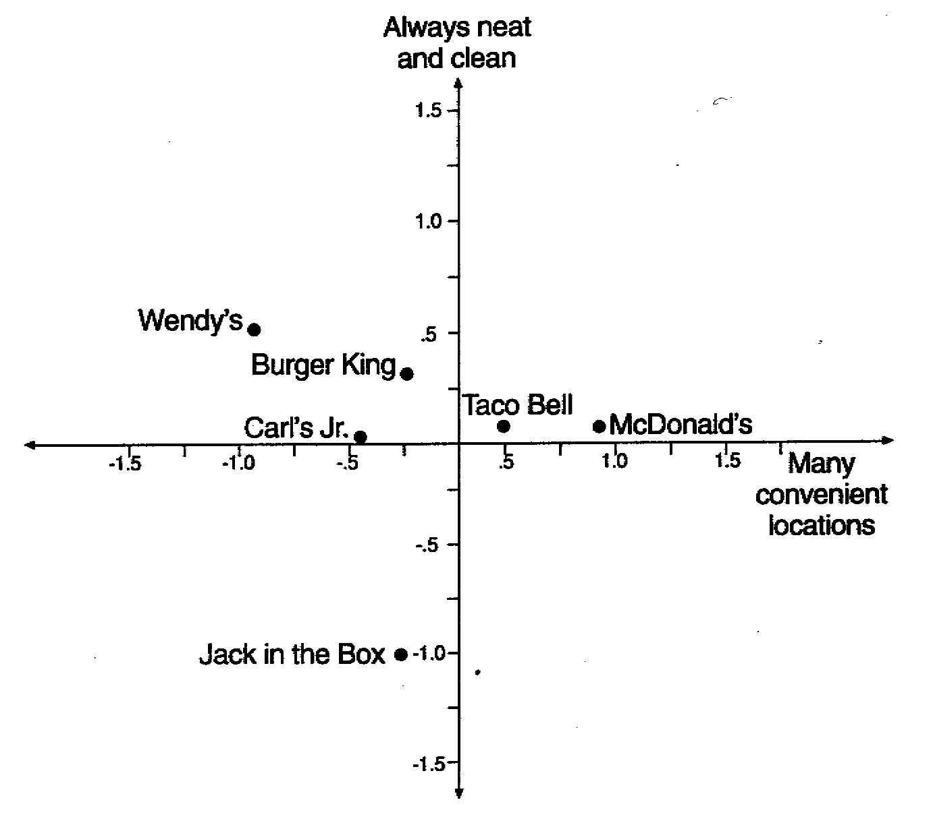
Positioning Map of American Fast-Food-Restaurants in the Mind of Consumers
Source: adapted from James H. Myers, Segmentation and Positioning for Strategic Marketing Decisions (American Marketing Association, Chicago, 1996), S. 187

Slide 11
High-Tech Positioning
Positioning stragtegy for products which are purchased on concrete product features; buyers typically already possess or wish to acquire considerable technical information
Suitable for
  technical products, such as computers or chemicals,
  special-interest products, such as sporting goods,
  products that can be demonstrated easily.; eg polaroid cameras

Slide 12
High-Touch Positioning
The emphasis lies more on the product’s image; specialised information appears of minor relevance
Suitable for
  products that solve a common problem; e.g., soft drinks
  global village products, such as cosmetics or fashion
  products that use universal themes; e.g. „heroism“ in Levis ads (jeans)

